Slide 1
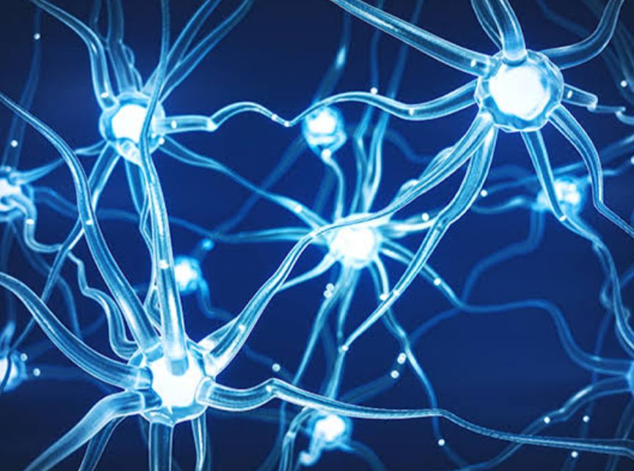
I
I
NEUROSCIENCE

Slide 2
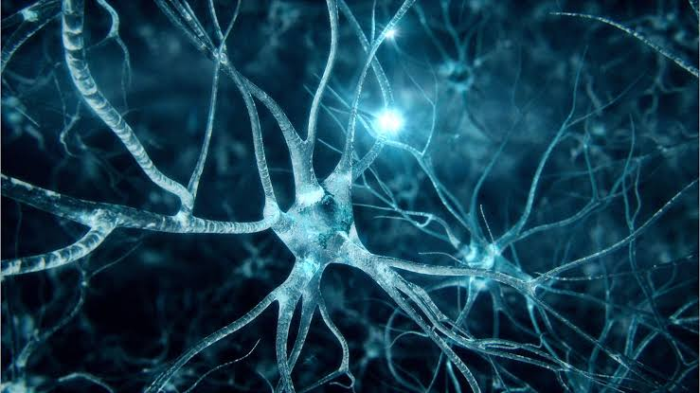
INTRODUCTION :
Neuroscience is the scientific study of nervous system.The scope of neuroscience has broadened over time to include different approaches.

Slide 3

HISTORY :
The founder of neuroscience has SANTIAGO RAMON Y CAJAL.Early study of the nervous system dates to ancient egypt.Early view on to the function of the brain regarded it to be a form of “CRANIAL STUFFING” of sorts.From the ancient egyptian mummifications to 18th century scientific research on “GLOBULES” and “NEURONS”.

Slide 4
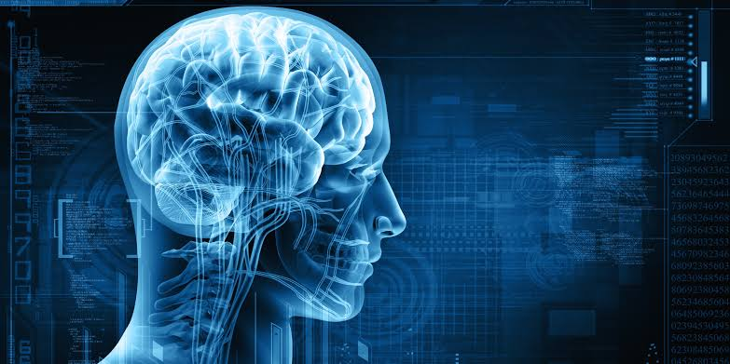
BRAIN NEUROSCIENCE :
The neuroscience of brain is a rich field devoted to studying the many facts of nervous system.The nervous system includes both the central nervous system consisting of a brain and spinal cord.

Slide 5
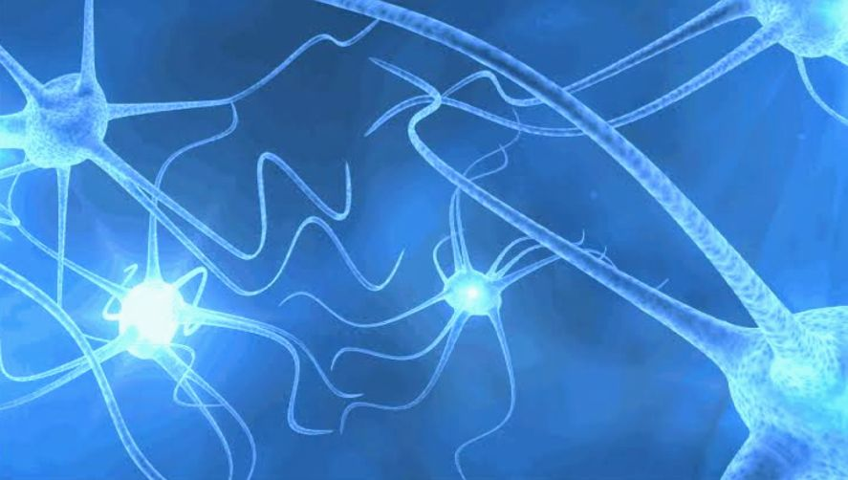
CONCEPTS OF NEUROSCIENCE :
Consiousness Neuroscience.
Perception Neuroscience.
Cognitive Neuroscience.
Behaviour Neuroscience.

Slide 6
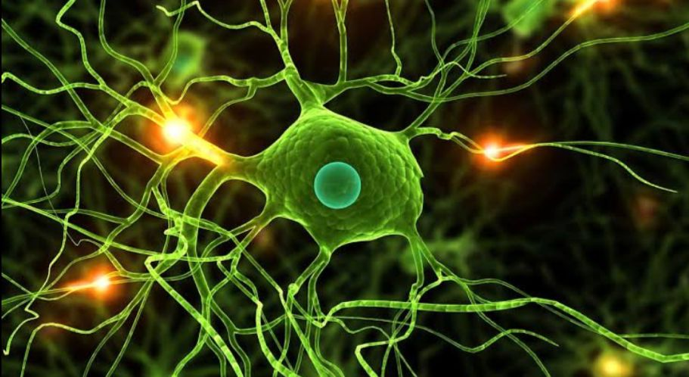
MODERN NEUROSCIENCE :
The father of modern neuroscience is CHRISTOPHER BERGLAND(THE ATHELETS WAY)The scientific study of the nervous system increased significantly during the second half of the 12th century.Due to the high degree of plasticity of the human brain.

Slide 7
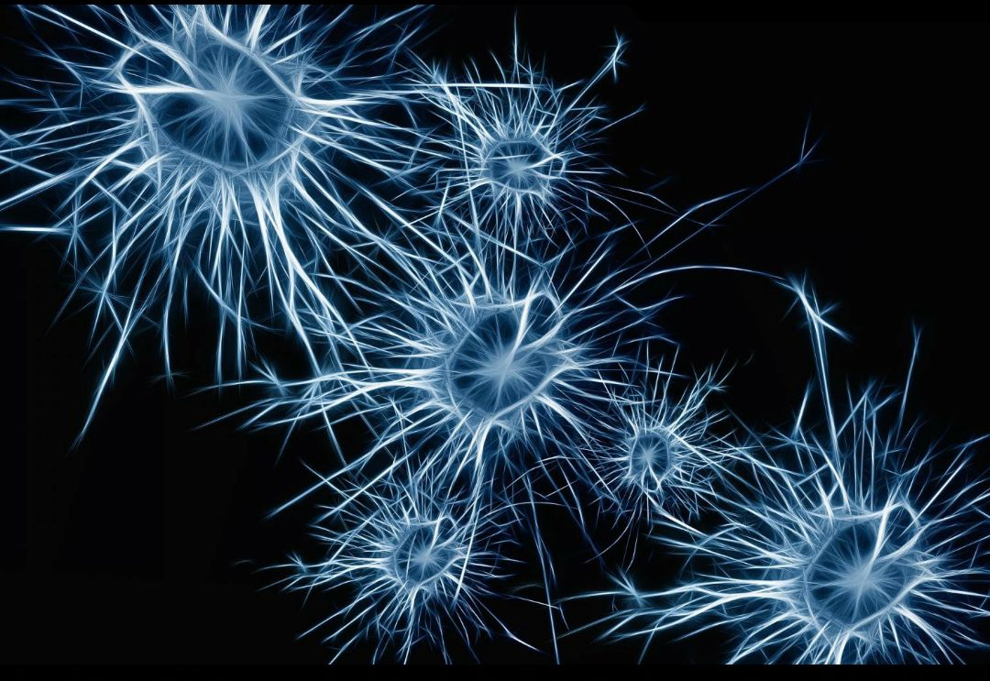
MAJOR BRANCHES :
Affective Neuroscience.
Behavioural Neuroscience.
Cellular Neuroscience.
Clinical Neuroscience.

Slide 8
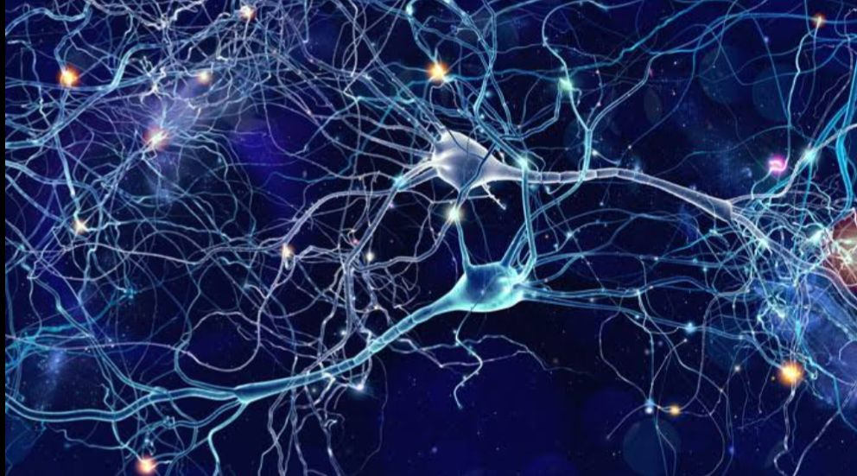
NEUROLOGY :
Neurology is a specialized area of medicine that concerns disorders.It involves diagnosing and treating conditions of the central,peripheral and autonomic nervous systems.

Slide 9
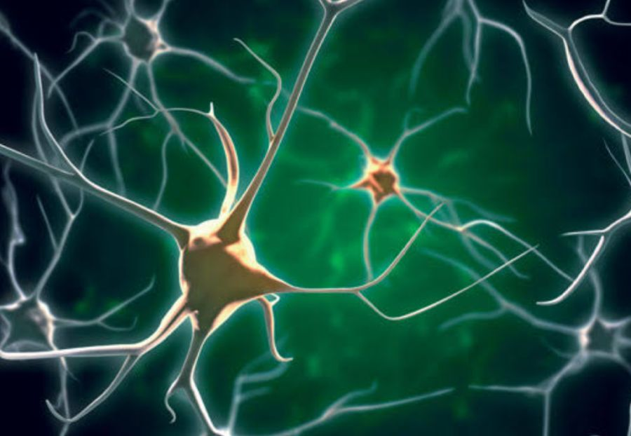
NEUROPHYSIOLOGY :
It stimulates with electrodes with ion or voltage sensitive dyes on light sensitive channels.
It has most closely associated with Biopsychology,Clinical Psychology,Cognitive Psychology and Developmental Psychology.

Slide 10
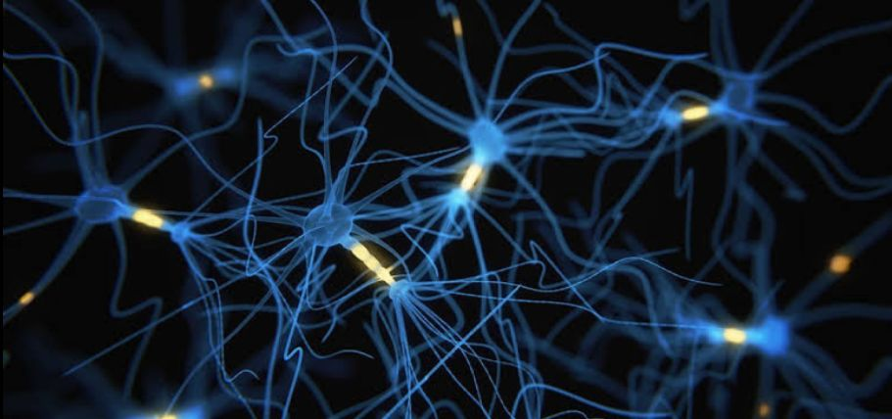
CONCLUSION :
It is making progress of understanding the essential stages of sleep and their function in normal neural process.The molecular mechanism of sleep homeostasis and circadian rhythms are being elucidated.

